Slide 1
Organizing scientific work on the internet

Slide 2
How to archive preprints?
One server desirable in theory
In practice: allow multiple experiments, see which works (already have several in operation)
Ginsparg: would perhaps construct a different system if starting today – experimentation could help arrive at best model

Slide 3
Indexing and preserving archive
Central site will index and archive preprints from all sites.
Housed at NLM?
Preprint must abide by agreed-upon standards to be indexed (like Pubmed, ArXiv)
Governing body of stakeholders will set policies, standards.

Slide 4
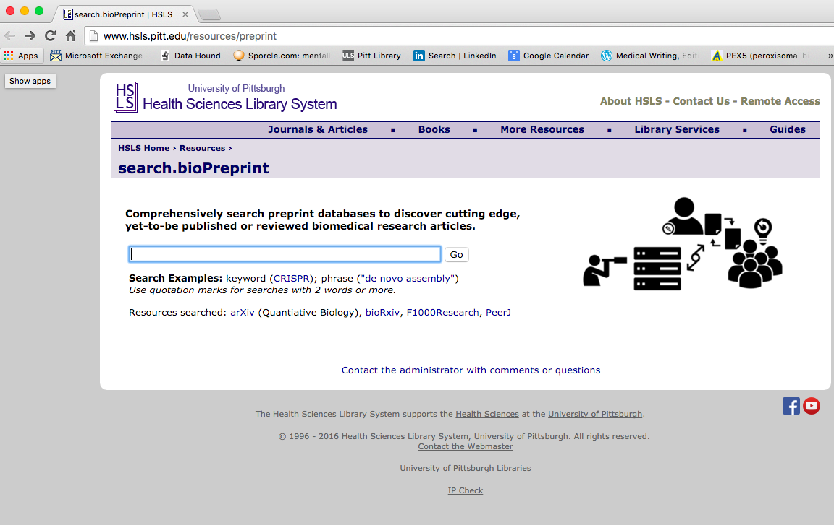
BioPreprint search engine at Pitt

Slide 5
Features of preprint archive
Follow open standards
DOI assigned
Allow versioning; preserves all versions
Retracted preprints noted as is case with papers
Multilingual (w/abstract in English)
Will require personnel who can understand article, determine if it meets minimum standards.
Provide metrics

Slide 6
Features of preprint archive
Include identifier as to whether paper is
preprint
published in journal
endorsed by post-publication review
Allow commenting

Slide 7
Other issues
Authorship – how to vouch? Have senior author respond on behalf of all authors?
What to call the different versions? Should we even use the term, “preprint”?
Proposal: Have community-wide competition to decide on names

